Slide 1
Analysis for
Graph-based SLAM algorithms
under Popular Frameworks
16833 Project Final Presentation
2021/05/05
Tianxiang Lin
Ben Zhou
Qishun Yu
Jiayin Xia
Kerou Zhang

Slide 2
Project Description
Tools for robustness test of pose graph optimization
Robust Kernels
Optimization Algorithms: GN/LM/DL
Datasets
Experiments
Poor initialization
Loop closure outliers
Notes:
http://ir.ia.ac.cn/bitstream/173211/19422/1/Comparison%20of%20methods%20to%20efficient%20graph%20SLAM%20under%20general%20optimization%20framework.pdf

Slide 3
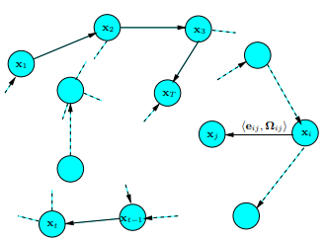

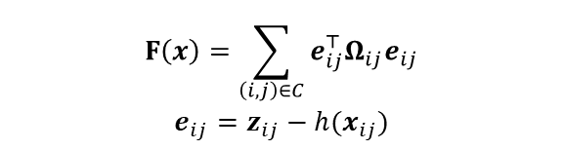
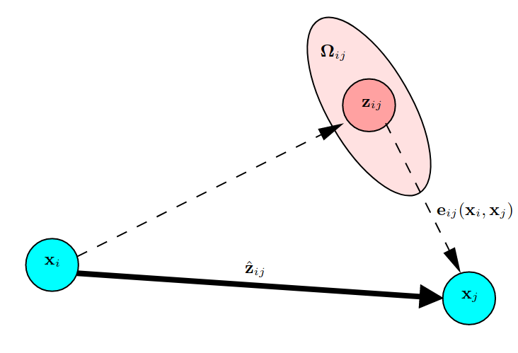

Graph-based SLAM
Goal
Objective Function
A pose-graph representation of a SLAM process*
Solving
Aspects of an edge connecting vertices*
* R. Kuemmerle, G. Grisetti, H. Strasdat, K. Konolige, W. Burgard, "g2o: A General Framework for Graph Optimization", In Proceedings of the IEEE International Conference on Robotics and Automation (ICRA), Shanghai, China, pp. 3607-3613, 2011.
Notes:
The optimization problem contains three principal elements: objective function, optimized variables, and constraints. Most optimization problems are too complex to directly derive the analytic form of the objective function's derivatives. Therefore, we solve optimization problems iteratively most of the time, for example, Gauss-Newton(GN) and Levenberg-Marquardt (LM).
Figure 6. Let x = (x1, . . . , xT ) T be a vector of parameters, where xi describes the pose of node i. Let zij and Ωij be respectively the mean and the information matrix of a virtual measurement between the node i and the node j.

Slide 4
Robust Kernels

Slide 5
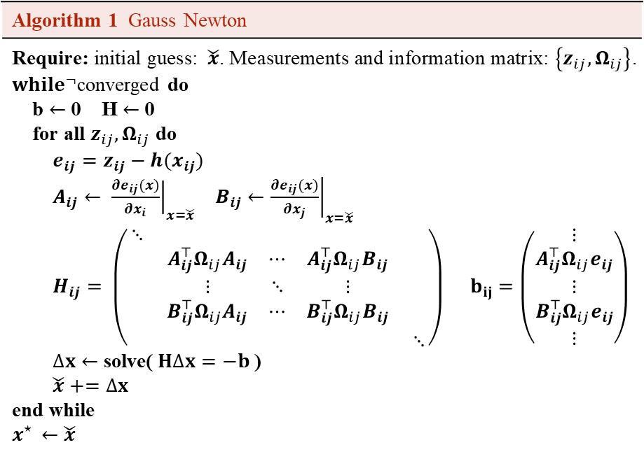
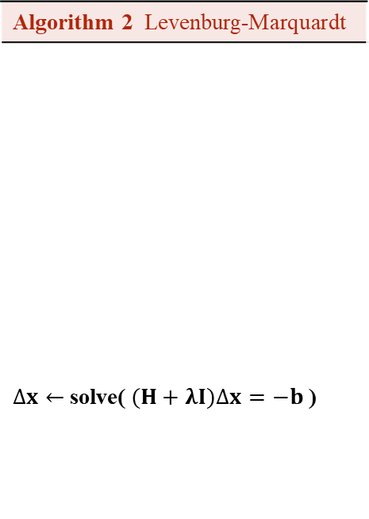
Optimization Algorithms
Algorithm 1 Gauss Newton
Require: initial guess:$\check{x}$. Measurements and information matrix: $\left\{z_{ij}, Ω_{ij}\right\}$. ${while}^{¬}$converged do b $←$ 0 H $←$ 0 for all $z_{ij}, Ω_{ij}$ do $e_{ij}=z_{ij}−h(x_{ij})$ $A_{ij}← {\left.\frac{∂e_{ij}(x)}{∂x_{i}}\right|}_{x=\check{x}}$ $B_{ij}←{\left.\frac{∂e_{ij}(x)}{∂x_{j}}\right|}_{x=\check{x}}$ $H_{ij}= \left(\begin{matrix}⋱ & & \\ & \begin{matrix}A_{ij}^{⊤}Ω_{ij}A_{ij} & ⋯ & A_{ij}^{⊤}Ω_{ij}B_{ij} \\ ⋮ & ⋱ & ⋮ \\ B_{ij}^{⊤}Ω_{ij}A_{ij} & ⋯ & B_{ij}^{⊤}Ω_{ij}B_{ij}\end{matrix} & \\ & & ⋱\end{matrix}\right) b_{ij}=\left(\begin{matrix}⋮ \\ \begin{matrix}A_{ij}^{⊤}Ω_{ij}e_{ij} \\ ⋮ \\ B_{ij}^{⊤}Ω_{ij}e_{ij}\end{matrix} \\ ⋮\end{matrix}\right)$ $∆x←$ solve($H∆x=−b$) $\check{x}+=∆x$ end while $$x^{⋆ }←\check{x}$$
Algorithm 2 Levenburg-Marquardt
$∆x←$ solve($(H+λI)∆x=−b$)
⁝
⁝
⁝

Slide 6
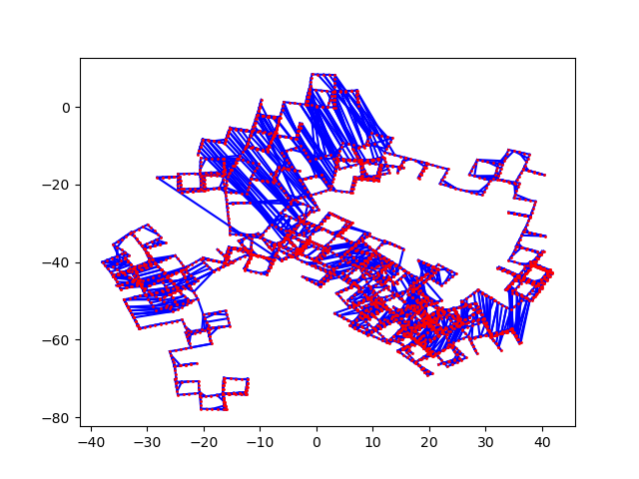
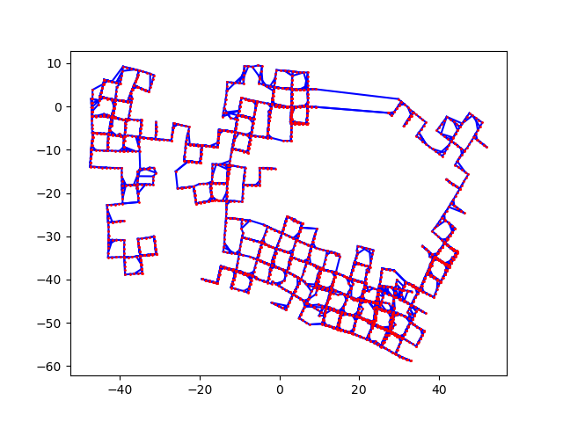
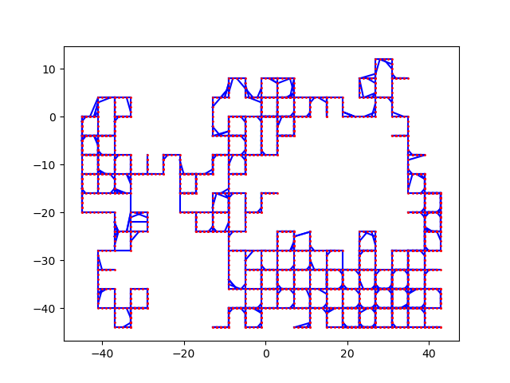
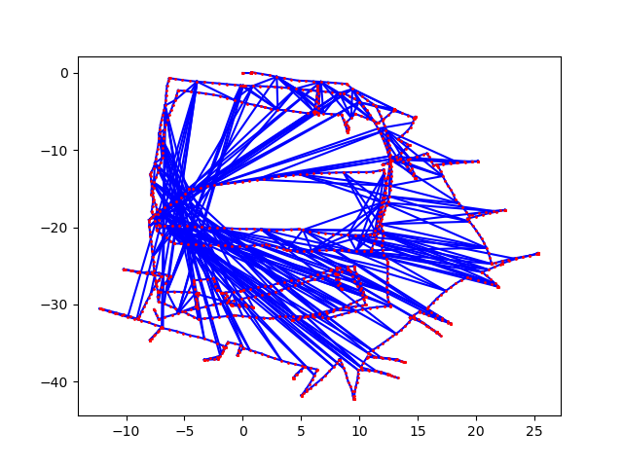
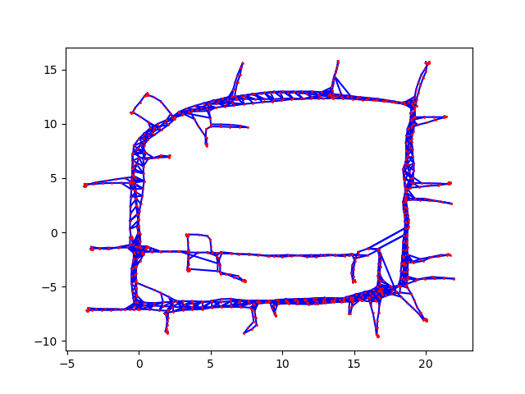
Datasets
Manhattan3500 (synthetic dataset)
Original dataset was by Olson
Second version included in g2o
Ground truth
Quality of the initial estimate: g2o closer to the ground truth
Intel Research Lab (real-world dataset)
Intel by Luca, obtained by processing the raw measurements from wheel odometry and laser range finder
Pseudo ground truth, estimation result provided in g2o
M3500 Olson
M3500 g2o
M3500 gt
Intel luca
Intel gt
Notes:
We use publicly available datasets, the Manhattan3500 and Intel Research Lab

Slide 7
Adding Outlier Loop Closure Constraints
Four adding policies:
Random Constraints
Any two random nodes in the graph.
Local Constraints
Two random nodes that are in the vicinity of each other.
Randomly Grouped Constraints
Create clusters of 10 mutually consistent outliers
Locally Grouped Constraints
Combination of the local and grouped policies

Slide 8
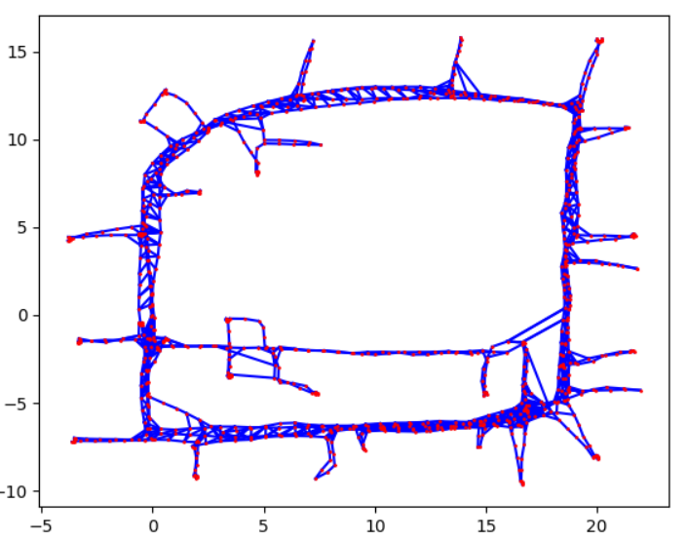
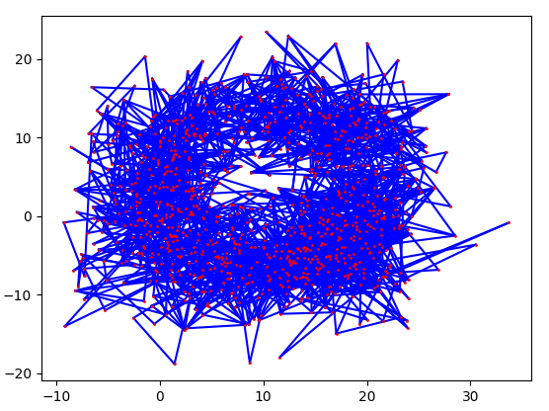
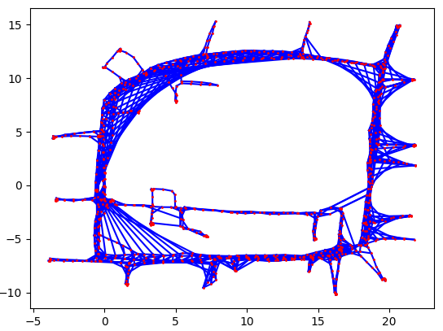
Experiments: Poor initial estimates & Outliers
Poor initialization: Add random values on ground truth to simulate bad initial guesses
Loop Closure Outliers: Modify edge values to simulate incorrect loop closure constraints

Slide 9
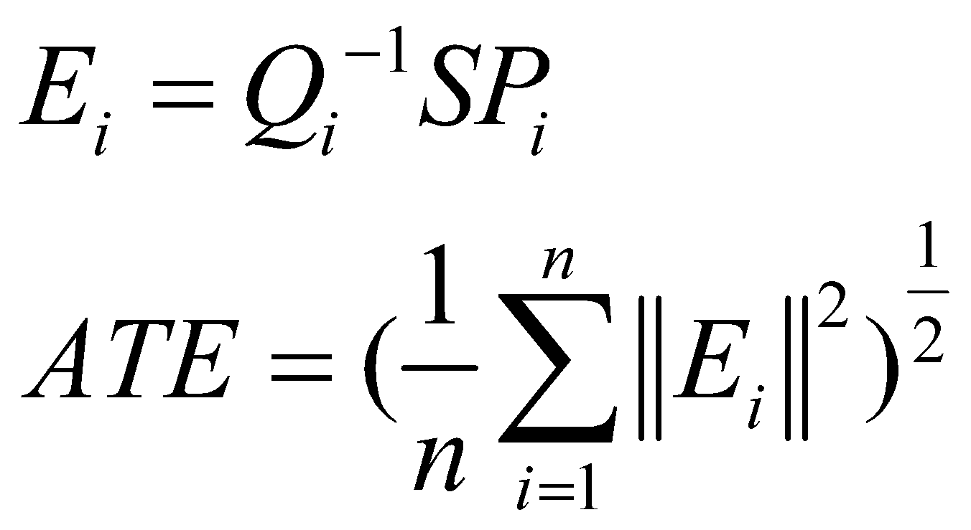
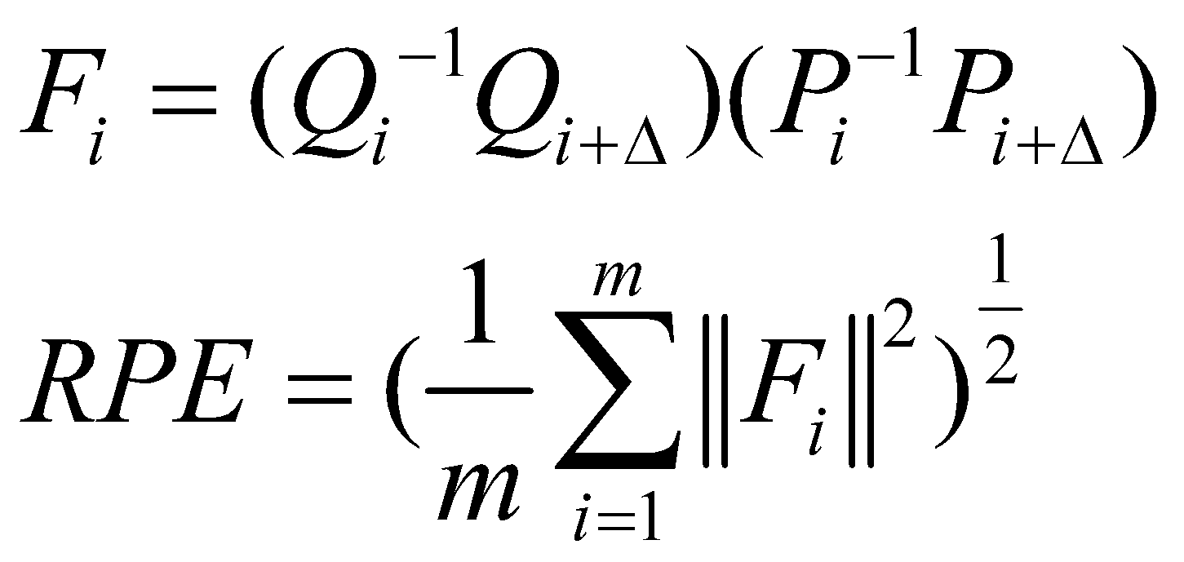
Experiments: Evaluation Metric
Absolute Trajectory Error (ATE)
The absolute distances between estimated and ground truth trajectory*.
Step
Align estimated trajectory P and ground truth Q by centroid.
Calculate ATE.
Relative Pose Error (RPE)
The local trajectory accuracy over a fixed time interval*.
Step
Define a fixed time interval Δ.
Compute drift of trajectory.
Calculate RPE.
* D. Prokhorov, D. Zhukov, O. Barinova, K. Anton and A. Vorontsova, "Measuring robustness of Visual SLAM," 2019 16th International Conference on Machine Vision Applications (MVA), 2019, pp. 1-6, doi: 10.23919/MVA.2019.8758020.

Slide 10
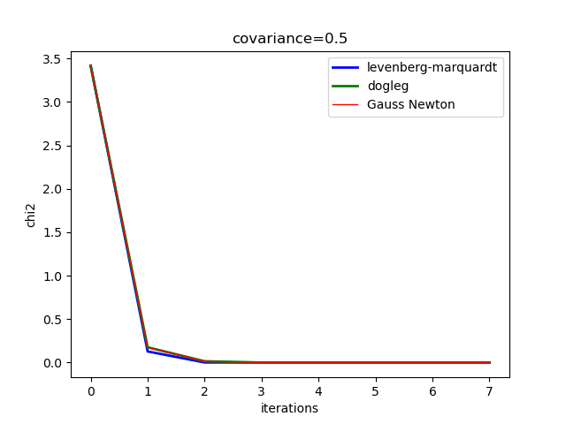
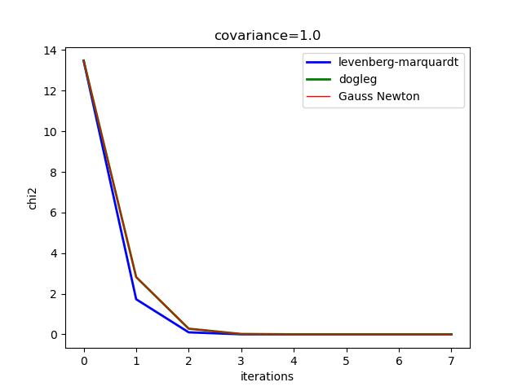
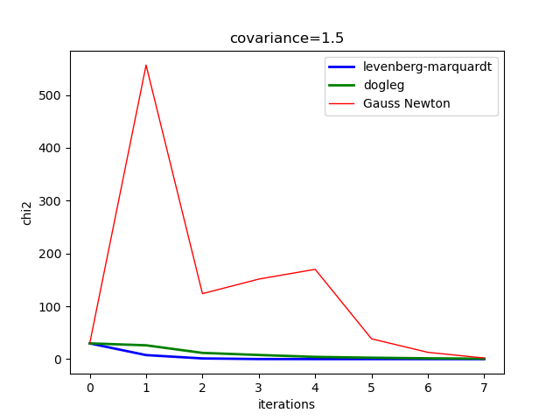
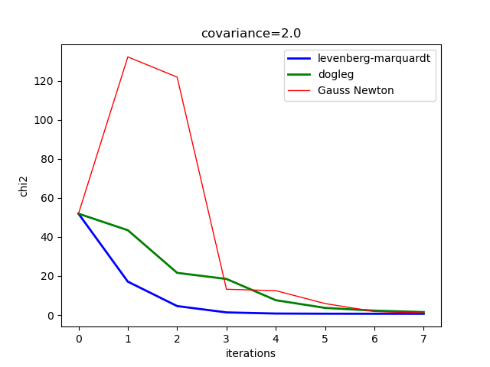
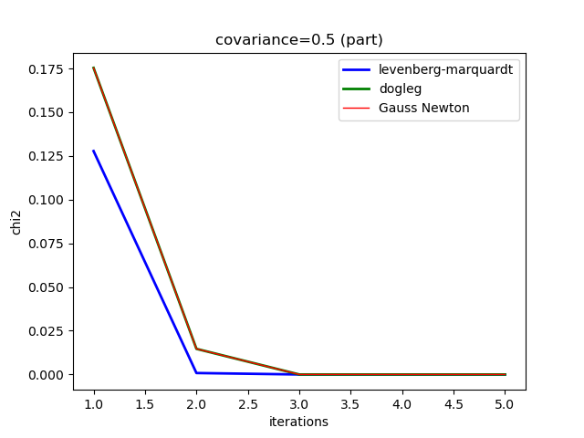
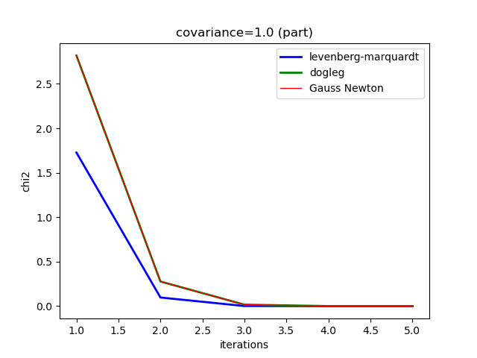
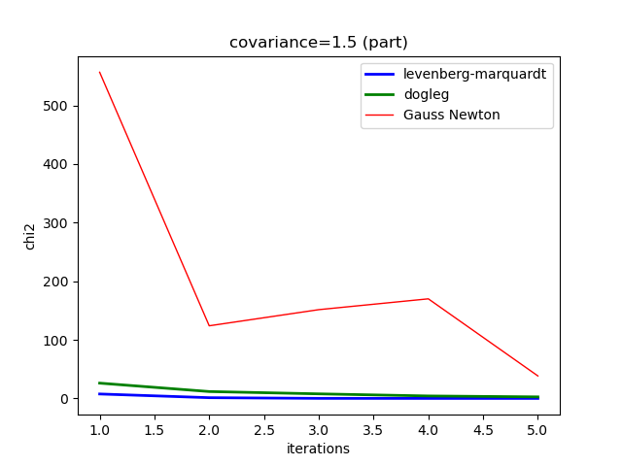
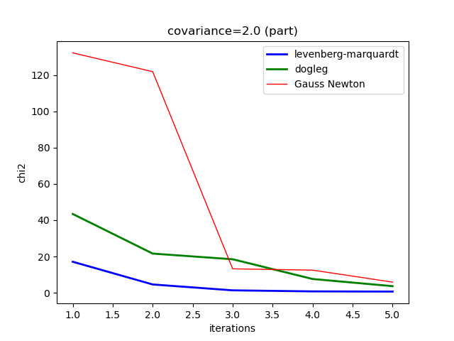
Experiment 1: How do different noise and poor initial estimate affect optimization algorithms?
Notes:
GN vs LM vs DL

Slide 11
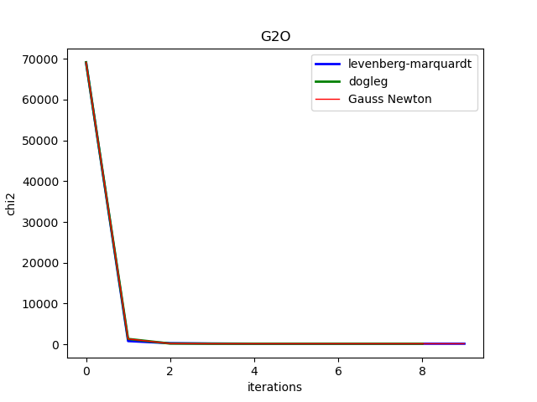
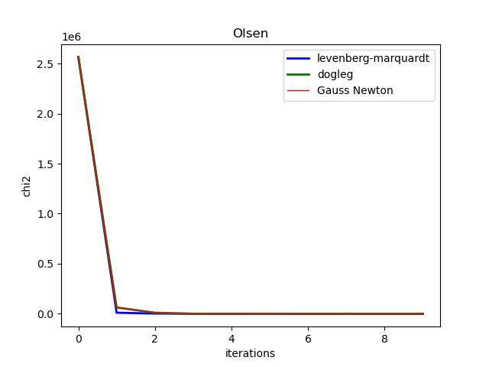
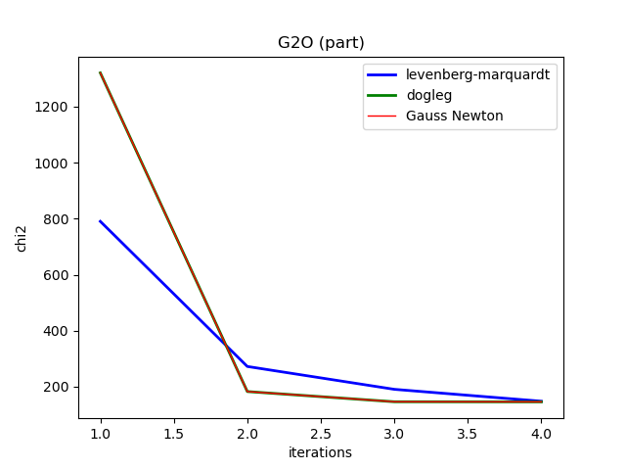
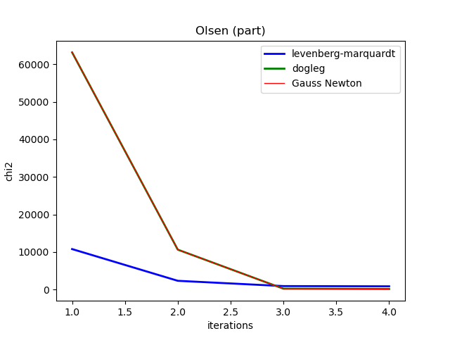
Experiment 1: How do different noise and poor initial estimate affect optimization algorithms?
Gauss-Newton Law has the quickest convergent speed but may show sawtooth-like behavior.
Dog-log sometimes uses GN for convergence, so their curves are similar.
Chi2 cannot become zero when initial guesses are bad.
Notes:
GN vs LM vs DL

Slide 12
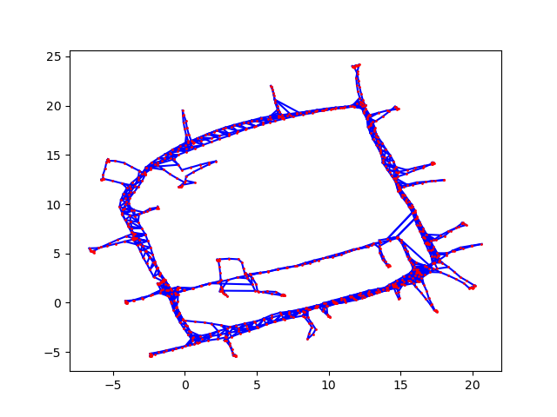
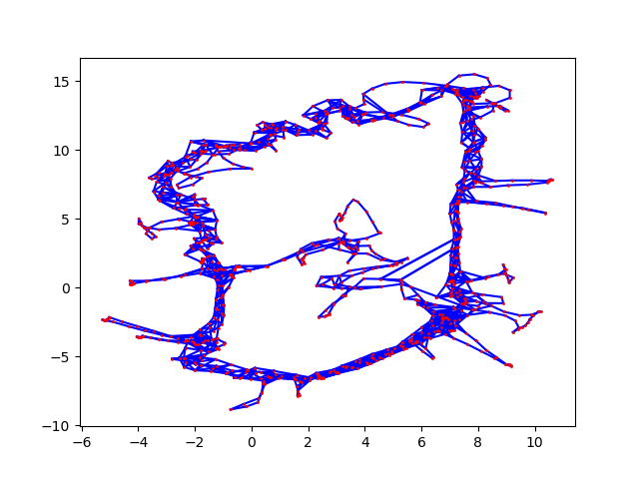
Experiment 2: How does Huber kernel react on poor initial estimates?
Huber Kernel
No Kernel
Notes:
Robust Kernel vs No Kernel (initial estimates)

Slide 13
Experiment 3: How do robust kernels react differently on close loop constraint outliers?
Notes:
Loop Closure

Slide 14
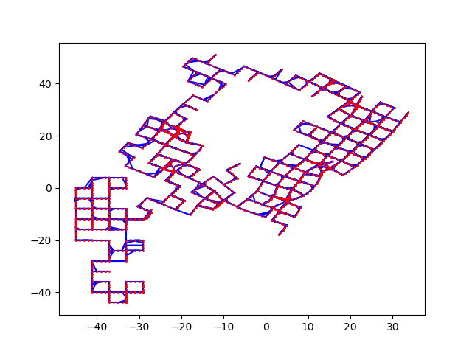
Experiment 3: How do robust kernels react differently on close loop constraint outliers?
Ground Truth
Optimized with 10 Incorrect Loop Closures
Notes:
Loop Closure
https://nikosuenderhauf.github.io/assets/papers/ICRA12-robustSLAM.pdf:
So called robust cost functions, like the Huber function [12], can reduce the influence of potential outliers. The idea of Huber is that the error function for data points whose error is above a certain threshold (also called the kernel width) should raise linearly instead of quadratically as is normally the case in least squares. This behaviour can be added easily to existing least squares solvers and is for instance optionally available in g2o [18]. However, robust cost functions are not sufficient to deal with outlier constraints like false-positive loop closures since the influence of outliers is merely reduced, but not removed. This however can still lead to defective solutions,as we see in Fig. 3(b) where a Huber function with kernel width 0.1 was used.

Slide 15
Experiment 4: How do different initial pose estimate respond to false loop closures?

Slide 16
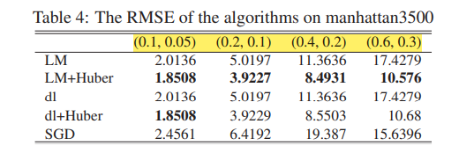
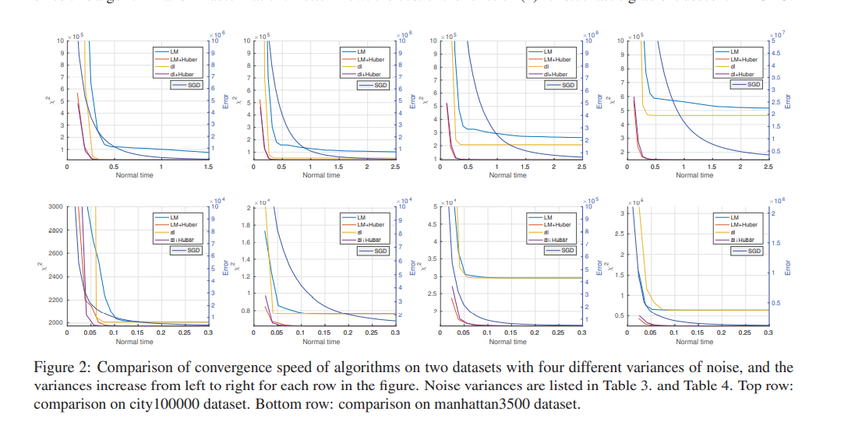
How different noise and poor initial estimate affects optimization algorithms
使用M3500 Olson
M3500 g2o
并在M3500 gt上添加intial 噪声
展示几张加噪声后的数据集的图片
生成如下表格 (用RPE and ATE)
和图片
Notes:
论文：Comparison of Methods to Efficient Graph SLAM Under General Optimization Framework

Slide 17
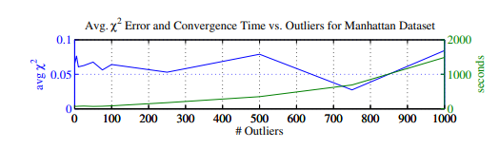
How robust kernels reacts differently on close loop constraint outliers
X:iterations
Y chi2
按benzhou说的做
1. 生成虚拟dataset，并展示几张加了outlier的优化前的图片
M3500的gt
adding 5, 10, 25, 50, 75, 100, 250, 500, 750 and 1000个outlier，其中平均使用strategy1，2，3，4，
2. 使用Geman, Huber, DCS，生成三张这种图片 （控制变量：all use g2o LM with CHOLMOD ）
X:outliers
Y:RPE chi2 ATE
Huber DCS Geman no kernel
对Intel gt上做相同工作
Notes:
https://nikosuenderhauf.github.io/assets/papers/ICRA12-robustSLAM.pdf:
So called robust cost functions, like the Huber function [12], can reduce the influence of potential outliers. The idea of Huber is that the error function for data points whose error is above a certain threshold (also called the kernel width) should raise linearly instead of quadratically as is normally the case in least squares. This behaviour can be added easily to existing least squares solvers and is for instance optionally available in g2o [18]. However, robust cost functions are not sufficient to deal with outlier constraints like false-positive loop closures since the influence of outliers is merely reduced, but not removed. This however can still lead to defective solutions,as we see in Fig. 3(b) where a Huber function with kernel width 0.1 was used.

Slide 18
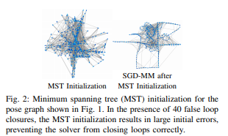
How different initial pose estimate responds to false loop closures
对比odometry和spanning tree 在不同的数量outliers的影响下的优化效果
控制变量（ all use g2o LM with CHOLMOD DCS）
. We use odometry as the initial pose estimate. Although minimum spanning trees are sometimes used for initialization, this approach results in large initial position errors when false loop closures are present (see Fig. 2).
Notes:
https://blog.csdn.net/qinxinger/article/details/106190975
https://april.eecs.umich.edu/media/pdfs/wang2014icra.pdf

Slide 19
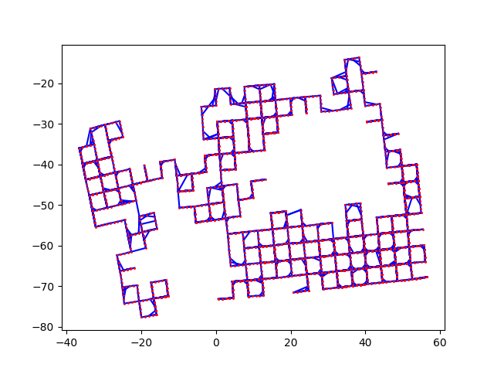
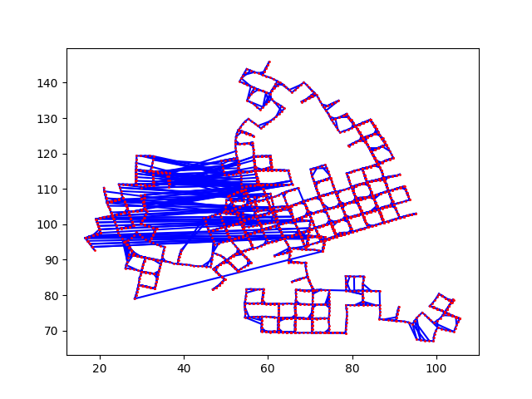

Experiment Results - M3500
M3500 ground truth
 | M3500 with 10 loop closure outliers | M3500a (Luca Carlone)
Chi2 | 6403.49 | 6024797.09
RPE | 14.78 | 32.42
ATE | 21.17 | 1061.53

Slide 20
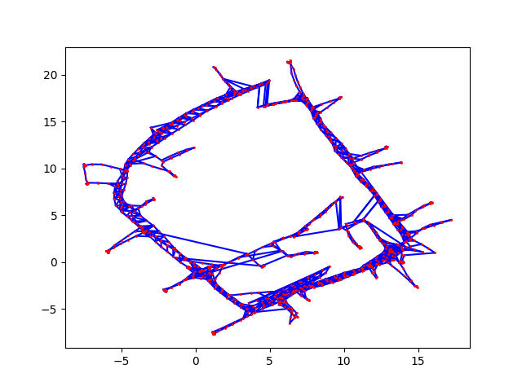
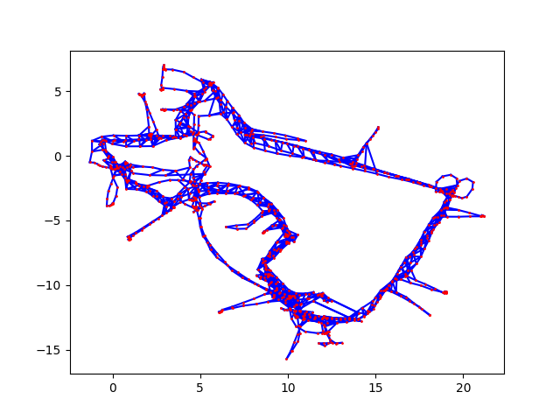
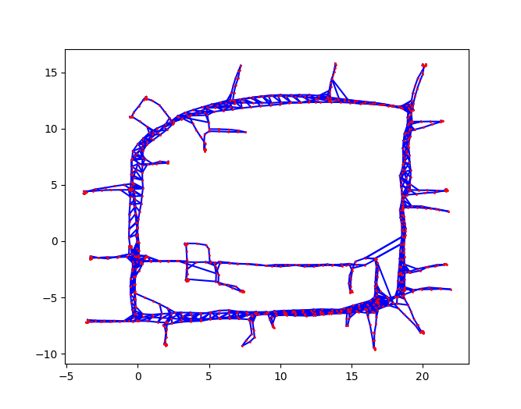
Experiment Results - Intel
 | 10 loop closure outliers & poor initial estimate (with robust kernel) | 10 loop closure outliers & poor initial estimate (without robust kernel)
Chi2 | 466908.98 | 2320754.15
RPE | 3828.79 | 3911.38
ATE | 2637.04 | 2738.46
INTEL ground truth
Notes:
10 loop closure: DL + German
noise + outlier: DL + huber

Slide 21
Summary & Future Work
Robust kernels help against poor initialization
Geman, Huber, DCS
Common kernels not very effective against loop closure outliers
It’s hard for good models to optimize bad data.
More experiments on different datasets and implementations of other kernels.

Slide 22
Possible questions
What’s the difference between g2o and gtsam?

